Slide 1
Hate Speech Dynamics Modelling on Social Networks

Slide 2

Background
Digital social media platforms are increasing being used to generate content
These digital platforms can influence real-life events ranging from inciting violence, hate speech, alter political campaigns, fake news spread to more benign use such as reaching out to people in need, raising fund and awareness for a cause etc.
These platforms are also extensively used to express opinions on real-life events, products among many others
Facebook has been blamed for instigating anti-Muslim mob violence in Sri Lanka as well as for playing a leading role in the possible genocide of the Rohingya community in Myanmar.

Slide 3
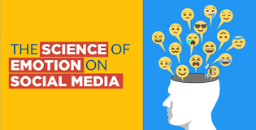
Background (cont’d)
The use-generated content is rich of emotions such as anger, hatred, joy etc. and affect such hate, sarcasm, irony, pun etc. as affect here
The presence of affect in user-generated content impacts the way it is perceived, disseminated and spread on the social media platforms

Slide 4


Topics
Spread Modelling
User-generated text and meta-data
Hate Speech Detection
Homophilic Analysis
Life-cycle Analysis

Slide 5
Approaches for Hate Speech Detection
Hate speech detection evolved from manually crafted lexical and linguistic features [5] to more sophisticated automatic feature selection using deep neural networks [8, 6, 7]
“Automated hate speech detection and the problem of offensive language” by Davidson et al. [45] showed that it is difficult to distinguish between hateful and offensive tweets.
Collected tweets containing hate lexicons and then used crowd-sourcing to label them as hateful, offensive and neither
Found that in some scenarios specially for sexist tweets difficult to distinguish offense and hate
Recently, “Predictive embeddings for hate speech detection on Twitter,” [47] used a Simple Word Embeddings-based based model to customize the word embedding to hateful content and showed that it beats state of the art model even with a much simpler model and much lesser parameters.
“Us and them: identifying cyber hate on Twitter across multiple protected characteristics,” by Burnap et al. [48] proposed a data-driven blended model to study the intersectionality of different forms of hate, specifically race and sexual orientation and shows it improves the machine classification of cyberhate

Slide 6
Approaches for Hate Speech Detection (cont’d)
“One-step and two-step classification for abusive language detection on twitter,” by Park et al. [49] modelled hate speech detection as a two-step approach using a neural network with two binary classifiers. In the first step, predict the presence of abusive speech, and in the second step, discern the form of offensive speech
Hate speech is contextual. “Locate the hate: Detecting tweets against blacks,” by Kwok et al. [50] argued that in the absence of contextual information, detecting hate from text is very difficult
[53, 54] suggested language evolves, and even benign words or phrases are being used to spread hate in closed communities as they associate personalised meaning, making detecting hateful content a challenging task.
In “Interpretable multi-modal hate speech detection,” Vijayaraghavan et al. [55] bridged the gap by using socio-political context to detect different categories of hate and showed why the explainability of model is very important
“Detecting online hate speech using context-aware models,” by Gao et al. [9] showed the importance of context in detecting hateful news articles and comments.

Slide 7
Approaches for Hate Speech Detection (cont’d)
Approaches which incorporates social aspect in hate speech detection in detail:
The effects of user features on Twitter hate speech detection [10]
investigate the effects of user features
incorporating network-related user features provided, resulted in improvement in hate detection
Showed on three different datasets, each in a different language
Used Logistic regression classifier

Slide 8
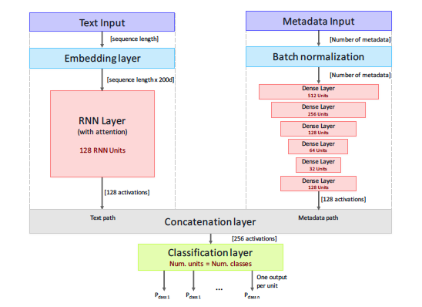
Approaches for Hate Speech Detection (cont’d)
A Unified Deep Learning Architecture for Abuse Detection [21]
Combines two classifiers, text and meta-data based. Text classifiers captures the linguistic aspect
meta-data captures three types of meta-data, tweets, user and network
Tweet-based (TF): Number of hashtags and mentions of other users; how many emoticons exist in the tweet; how many words there are with uppercase etters only; the number of URLs included. Moreover, tweets’ sentiment (i.e., positive/negative score), specific emotions (i.e., anger, disgust, fear, joy, sadness, and surprise), and offensiveness scores are considered
User-based (UF): # of followers/followees, activity (# of tweets posted and # of favourites)
Network-based (NF): reciprocity, centrality scores, clustering coefficient
Showed the effectiveness of proposed approach on four datasets
Hate, Cyberbullyeing, Sarcasm and Offensive Dataset

Slide 9
Thank You

